Slide 1
Laying out and designing a container
Module: UI Design, Lecture 3

Slide 2
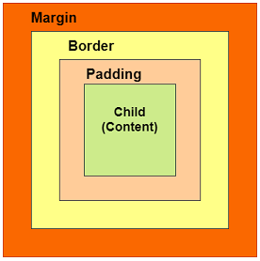
Container
The container is probably the most widely used layout widget
You will be surprised at how much power a container gives you!
Let’s check the anatomy of a container

Slide 3
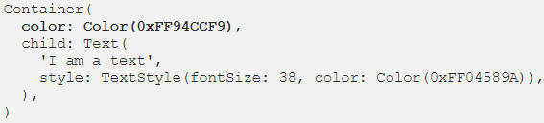
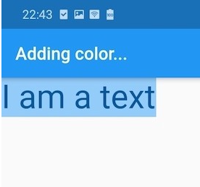
Container
We all have used containers like this:

Slide 4
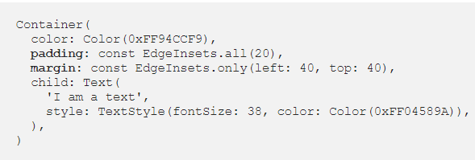
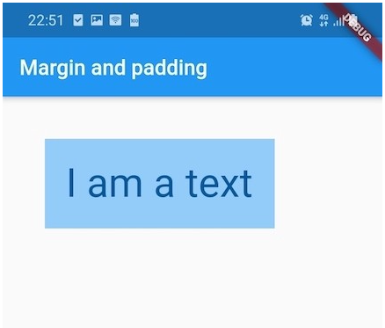
Container: Padding and margin
Let’s add a padding and a margin.
Padding adds space between child and the border
Margin adds space outside the border

Slide 5
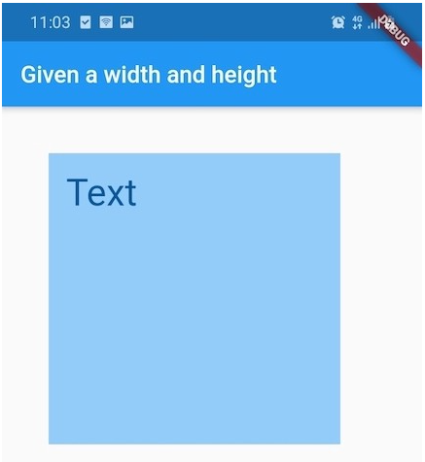
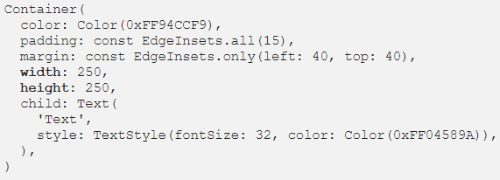
Container
If we define the container’s width and height, the container will honor these dimensions.
But if we don’t, it will be as small as possible, wrapping the child with padding.
The child will be aligned inside the container to the top-left corner by default

Slide 6
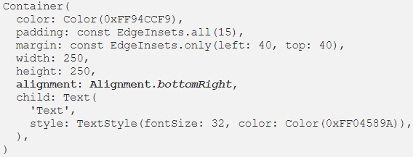
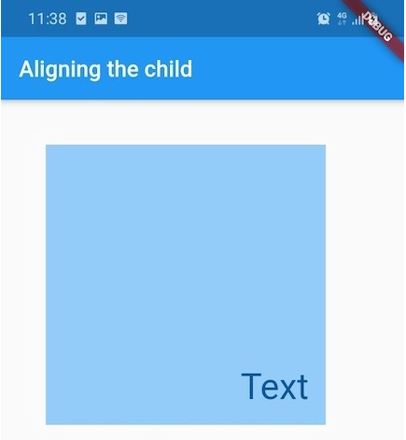
Container: Alignment
But if we wish, we can align the child anywhere, like this -

Slide 7
Alignment
There are the following predefined values for alignment:
topLeft
topCenter
topRight
centerLeft
center
centerRight
bottomLeft
bottomCenter
bottomRight

Slide 8
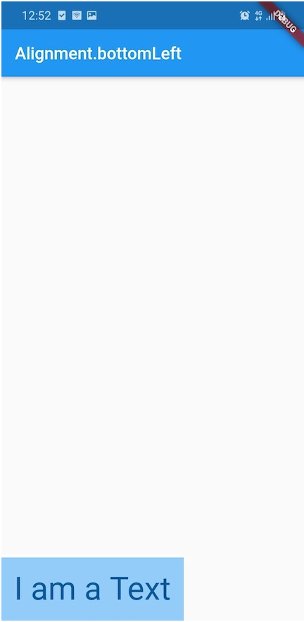
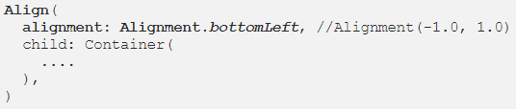
Alignment
You don’t always need containers for alignment. There is a separate alignment widget for this.

Slide 9
Align widget using width and height factors
Aligning to a concrete position inside the parent widget using double values for widthFactor and heightFactor in the constructor.
Both factors, in their corresponding dimensions, go from -1.0 value to 1.0 value.
For example, when it comes to widthFactor : -1.0 is the left border, 0.0 is the center, and 1.0 is the right border. Going further, -0.5 means the point in the middle between the left border and the center

Slide 10
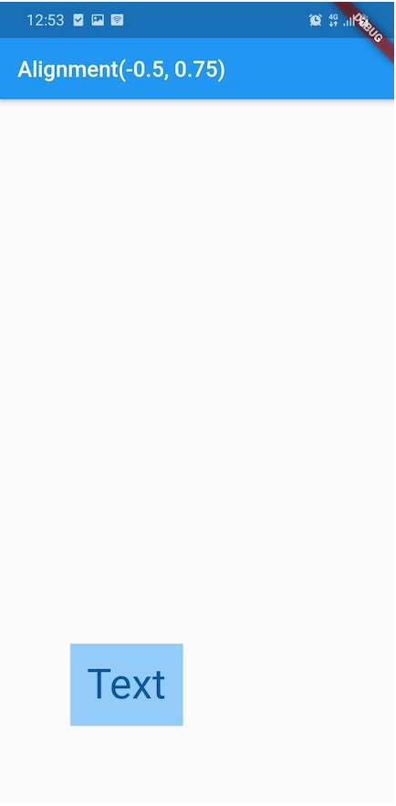
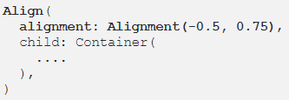
Align widget using width and height factors
For example,

Slide 11
Container Decoration

Slide 12
Decoration
We can choose a color background, an image background, a shape, a border, a corner shape (borderRadius), a shadow, and a gradient.
This is not an exhaustive description of using these properties but only giving some examples of usage.
If we use the decoration property in a container then the container’s color property must be inside the decoration class.

Slide 13
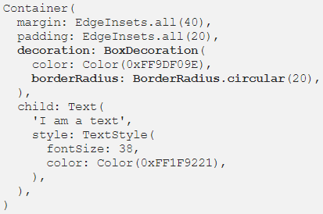
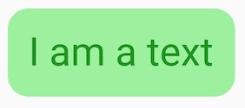
Decoration
Try it out

Slide 14
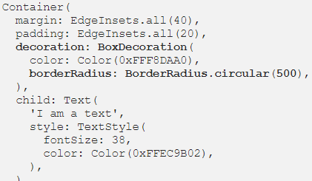
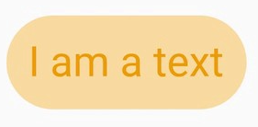
Decoration
Or how about this, when the border-radius is big enough to achieve a completed-vertical rounded shape on every side (left and right)?
We can get it giving a big value as border-radius.

Slide 15
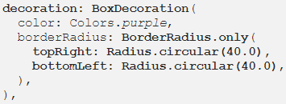
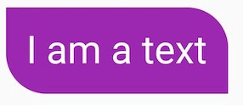
Decoration
Try this

Slide 16
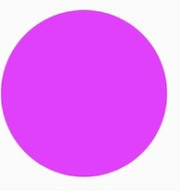
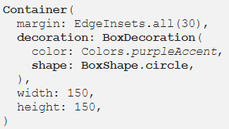
Decoration
How about making a perfect circle?
Challenge: Can you achieve the same effect without using the shape attribute? (Using borderRadius, width, and height property)

Slide 17
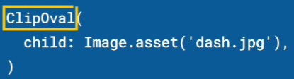
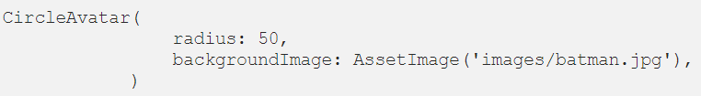
Widgets for perfect circle
You can use a ClipOval. It cuts the child to fit it inside an oval. Rectangular child gives you an oval. Square child gives a circle.
Or use a CircleAvatar. If you don’t need an background image, just add a Container as its child.

Slide 18
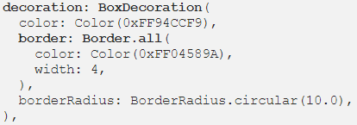
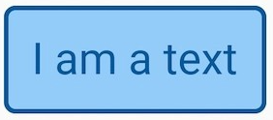
Decoration
You can add a thick border like this

Slide 19
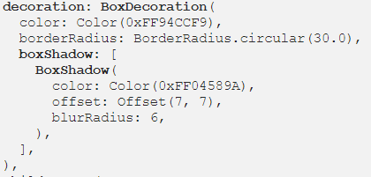
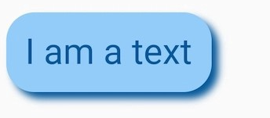
Decoration
We set a shadow effect by using the boxShadow property.

Slide 20
Decoration
We use the offset property to tell the displacement of the shadow.
We can add blur to soften the shadow edge.
We can also set opacity of color like this -
color: Color(0xff00D99E).withOpacity(.6)

Slide 21
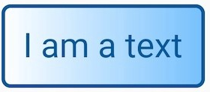

Decoration

Slide 22
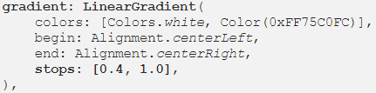
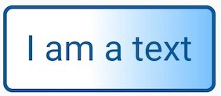
Decoration
We can use stops to give value to one color.
For example, to give more importance to the left color (white), we provide a value greater than 0.0 to the first stop:

Slide 23
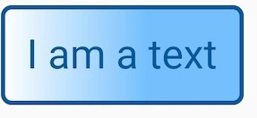
Decoration
Or we use stop values [0.0, 0.6] to emphasize on the right color.

Slide 24
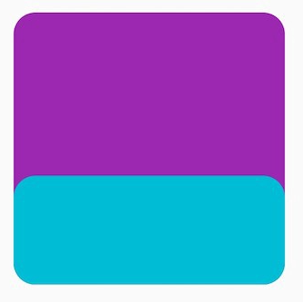
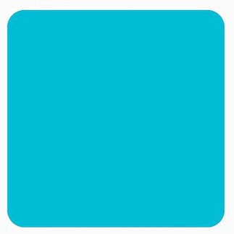
Container: Constraints
If the Container widget has no child, no height, no width, no constraints, and no alignment, but the parent provides bounded constraints, then Container expands to fit the constraints provided by the parent.
Parent container has width and height defined, but child has only height defined
And now, child has neither height nor width defined

Slide 25
Boss level challenges

Slide 26

Boss level challenge - 1
Align the design to topCenter of the screen
Set a top-margin to separate it from the AppBar
Align the text ‘H’(or any letter) to the center of the parent container
Use only instances of Align, Container, and Text widgets, and their properties

Slide 27
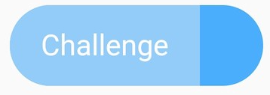
Boss level challenge - 2
Use any two colors here. The challenge is the copy this shape and use two different colors like this.

Slide 28
Thank you

